Slide 1
Chapter 2
Introduction to XHTML
Programming the World Wide Web
Fourth edition
By Robert W. Sebesta

Slide 2
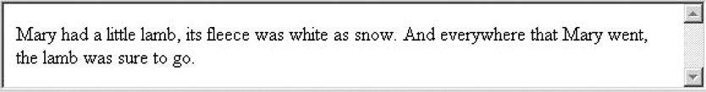
Figure 2.1 Filling lines

Slide 3

Figure 2.2 Display of greet.html

Slide 4
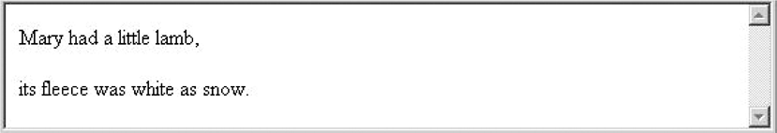
Figure 2.3 The paragraph element

Slide 5
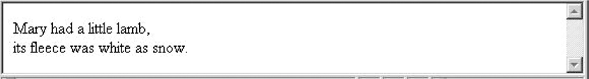
Figure 2.4 Line breaks

Slide 6
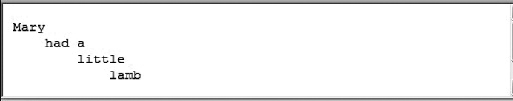
Figure 2.5 The pre element

Slide 7
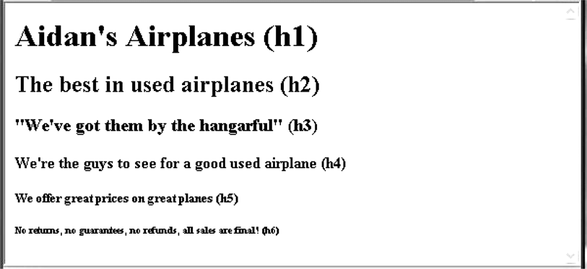
Figure 2.6 Display of headings.html

Slide 8
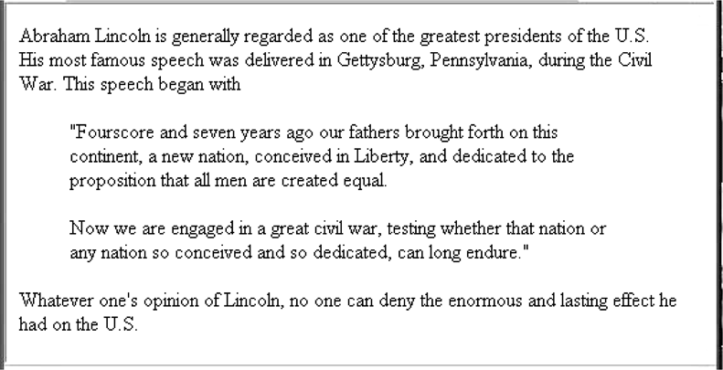
Figure 2.7 Display of blockquote.html

Slide 9

Figure 2.8 The <code> element

Slide 10

Figure 2.9 The <sub> and <sup> elements

Slide 11
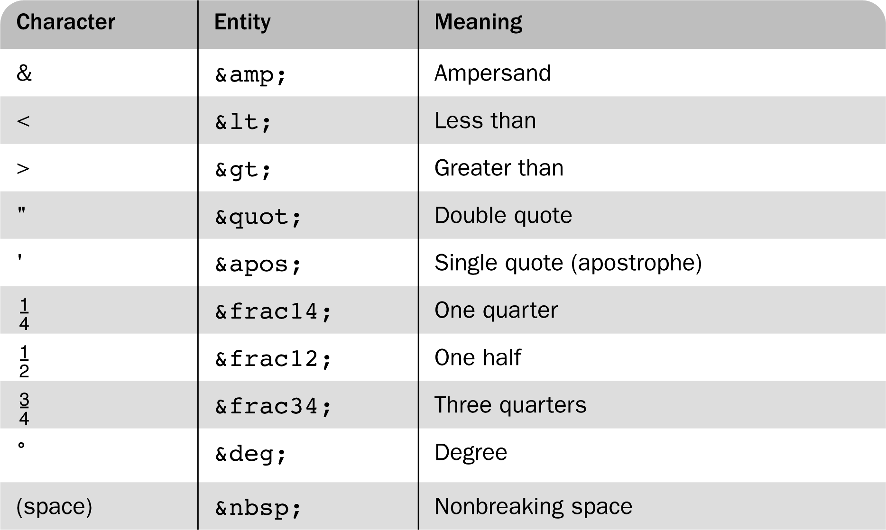
Table 2.1 Some commonly used entities

Slide 12
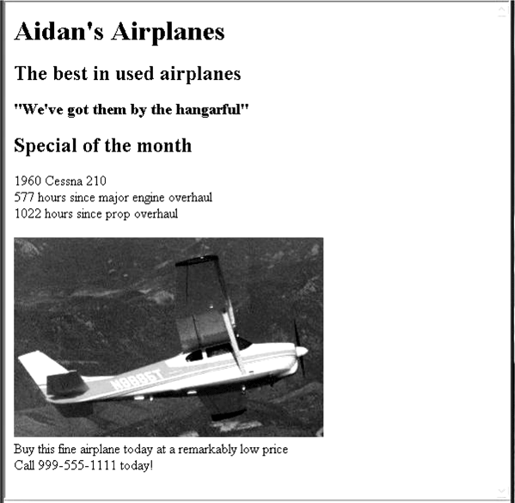
Figure 2.10 Display of image.html

Slide 13
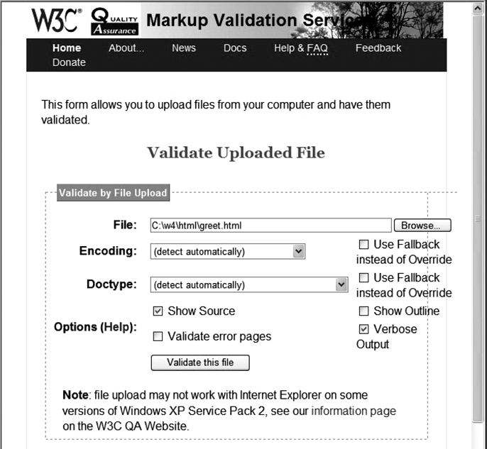
Figure 2.11 Display of file-upload.html, the W3C HTML validation

Slide 14
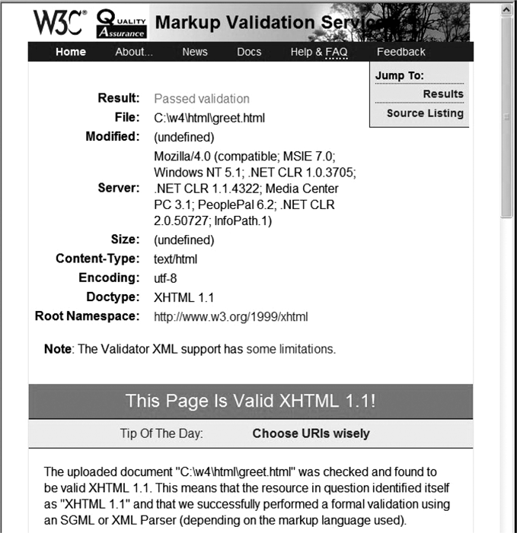
Figure 2.12 HTML validation output for image.html

Slide 15
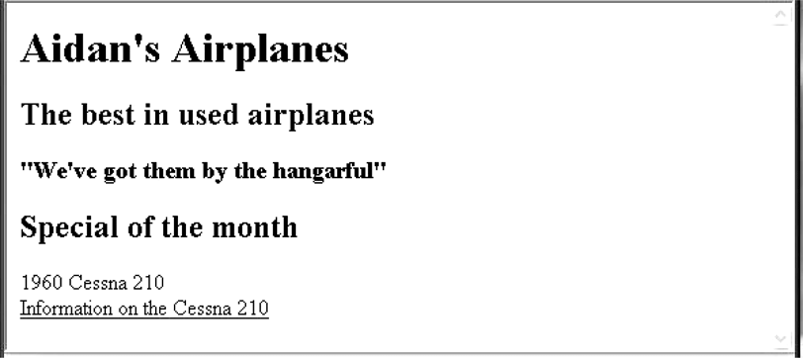
Figure 2.13 Display of link.html

Slide 16
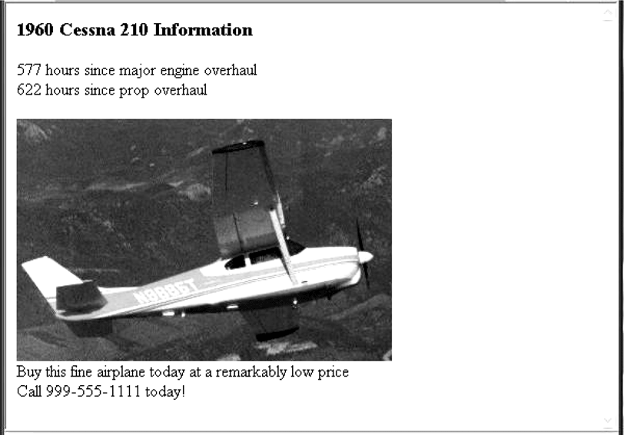
Figure 2.14 Following the link from link.html

Slide 17
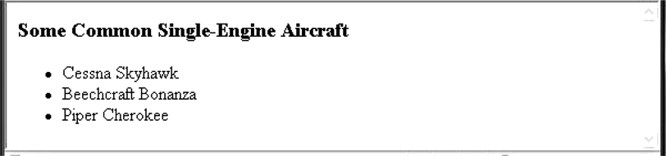
Figure 2.15 Display of unordered.html

Slide 18
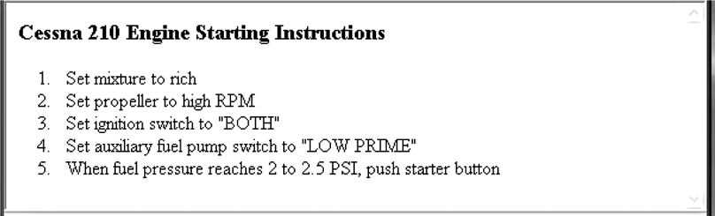
Figure 2.16 Display of ordered.html

Slide 19
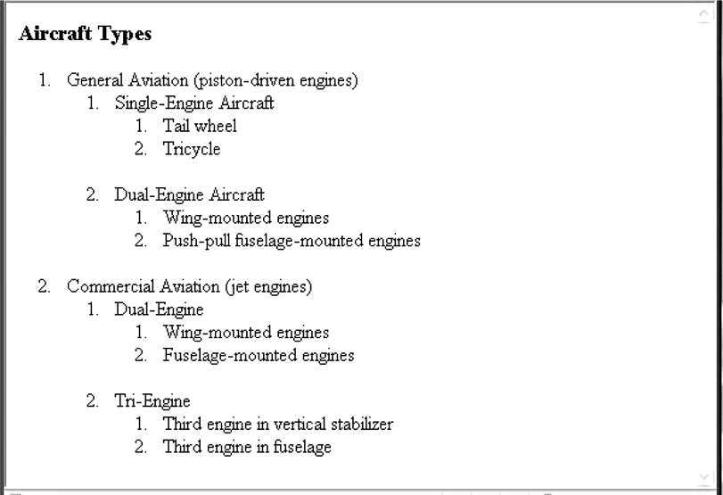
Figure 2.17 Display of nested_lists.html

Slide 20
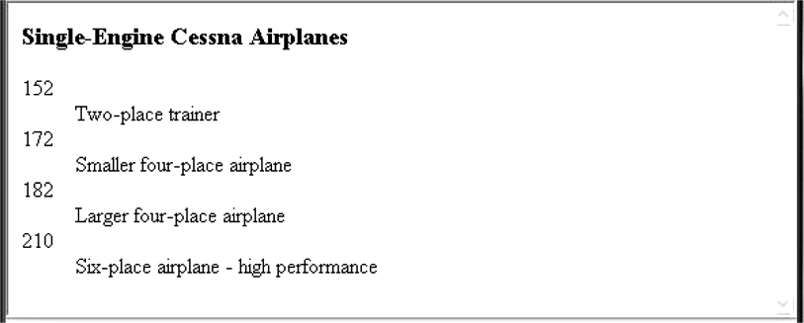
Figure 2.18 Display of definition.html

Slide 21
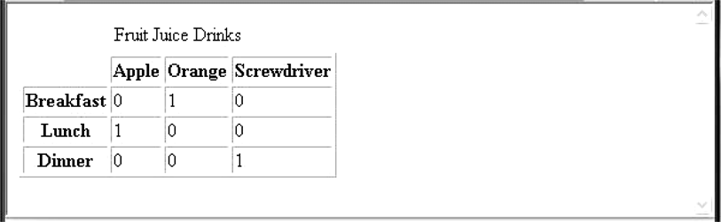
Figure 2.19 Display of table.html

Slide 22
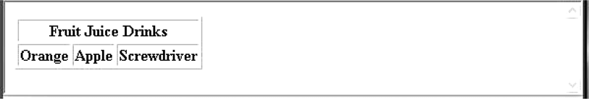
Figure 2.20 Two levels of column labels

Slide 23
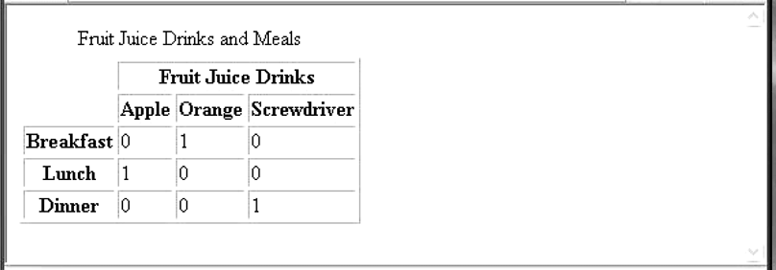
Figure 2.21 Display of cell_span.html: multiple-labeled columns and labeled rows

Slide 24
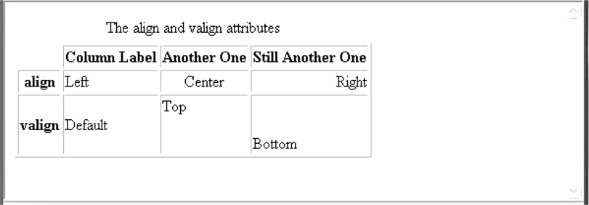
Figure 2.22 Display of cell_align.html: the align and valign attributes

Slide 25
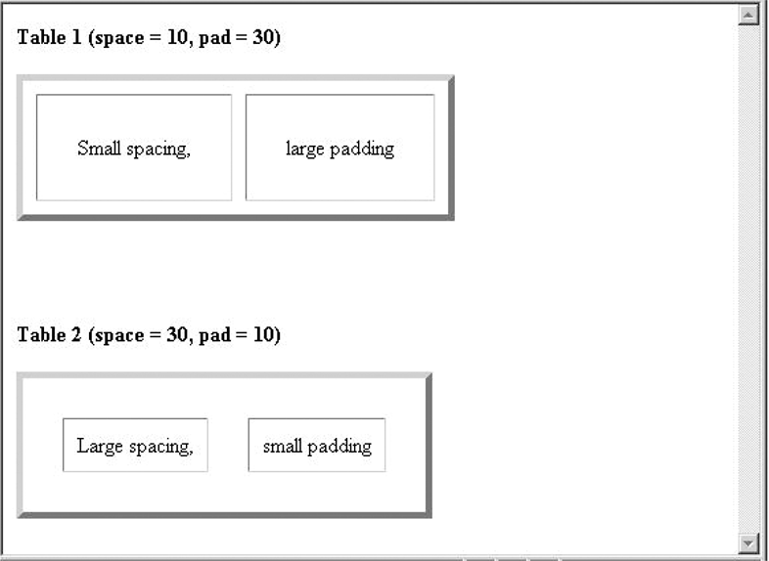
Figure 2.23 Display of space_pad.html

Slide 26
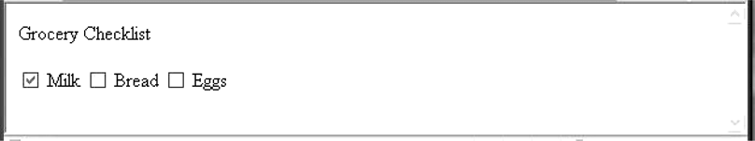
Figure 2.24 Display of checkbox.html

Slide 27
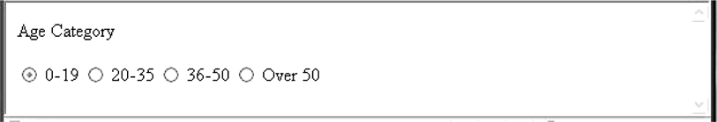
Figure 2.25 Display of radio.html

Slide 28
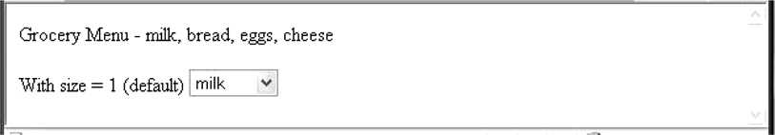
Figure 2.26 Display of menu.html (default size of 1)

Slide 29
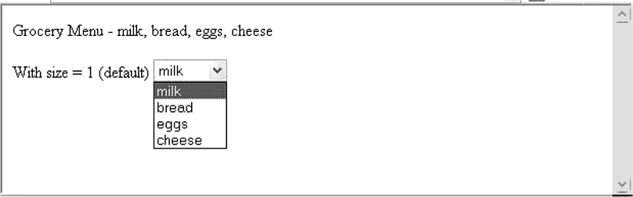
Figure 2.27 Display of menu.html after the scroll arrow is clicked

Slide 30
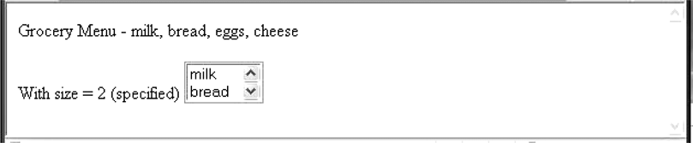
Figure 2.28 Display of menu.html with size set to 2

Slide 31
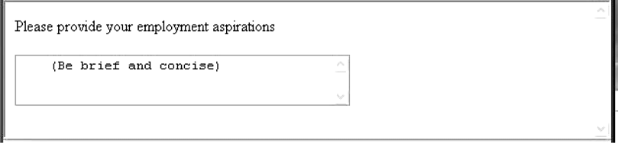
Figure 2.29 Display of textarea.html after some text entry

Slide 32

Figure 2.30 Submit and Reset buttons

Slide 33
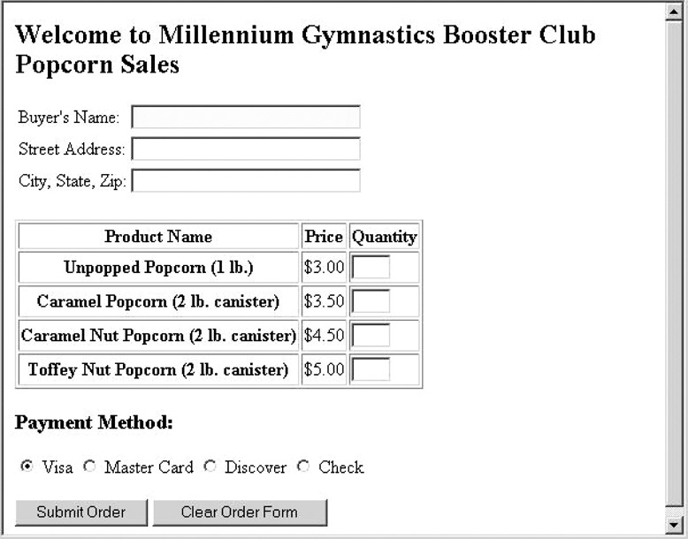
Figure 2.31 Display of popcorn.html

Slide 34
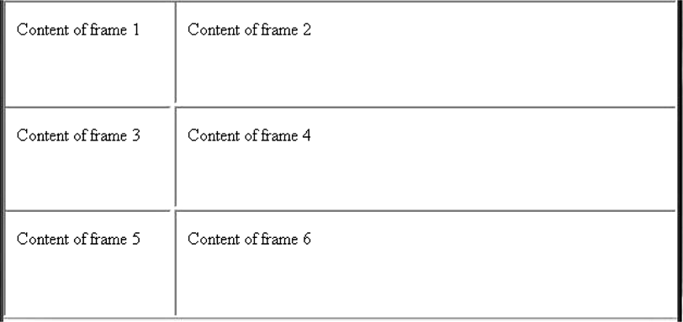
Figure 2.32 A simple frameset of six frames

Slide 35
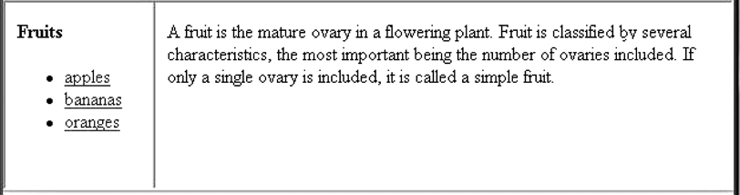
Figure 2.33 Display of frames.html

Slide 36
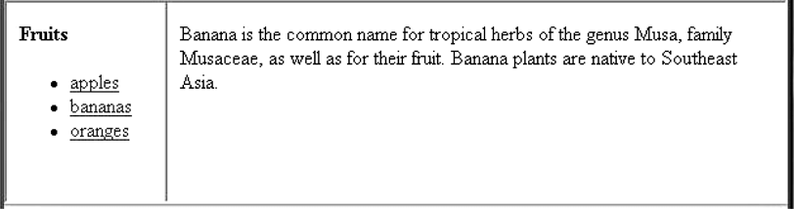
Figure 2.34 Display of frames.html after taking the bananas link

Slide 37
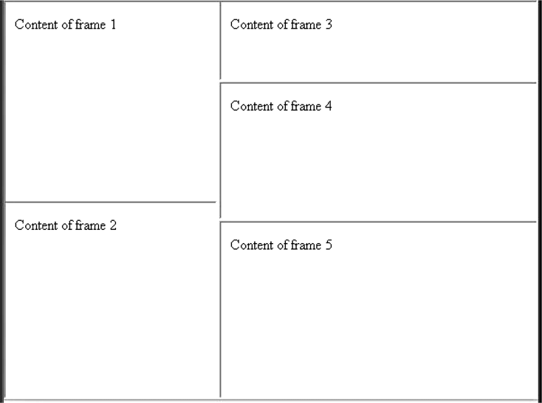
Figure 2.35 Display of nested_frames.html

